Slide 1
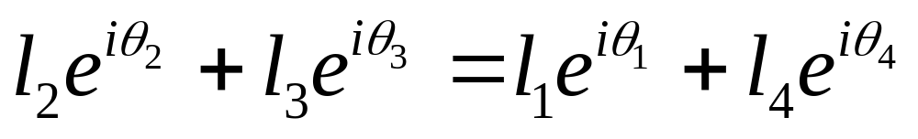
Limit Position Analysis of a Non Grashofian Double Rocker RRRR Linkages Using Complex Numbers
P
Im
Q
θ₅
l₃
l₄
l₅
θ₃
l₂
θ₄
θ₂
l₁
θ₁
Re
O
Viewing the point P from two directions in the complex plane

Slide 2
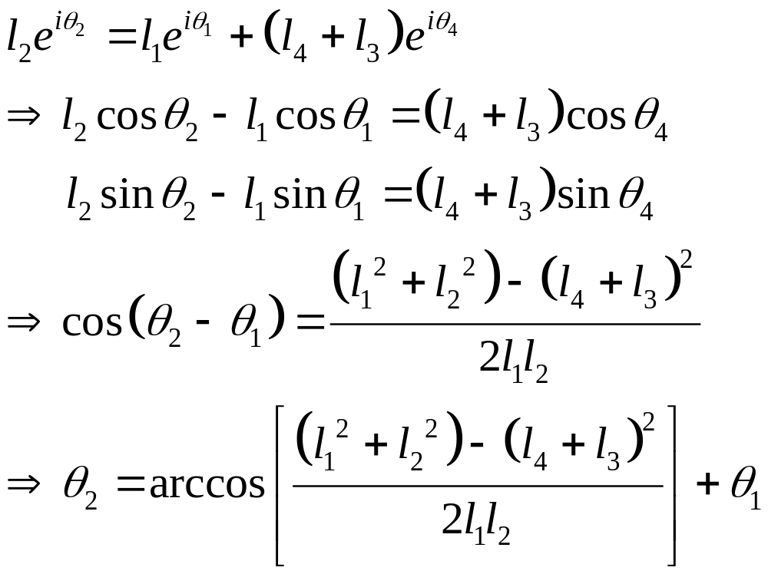
Limit Position Analysis of a Non Grashofian Double Rocker RRRR Linkages Using Complex Numbers
Type I (L_{max}=L₁) : θ₂ - one extreme position
l₅
Q
θ₅
P
Im
l₂
l₃
θ₃
l₄
θ₄=θ₃
θ₂
l₁
θ₁
Re
O

Slide 3
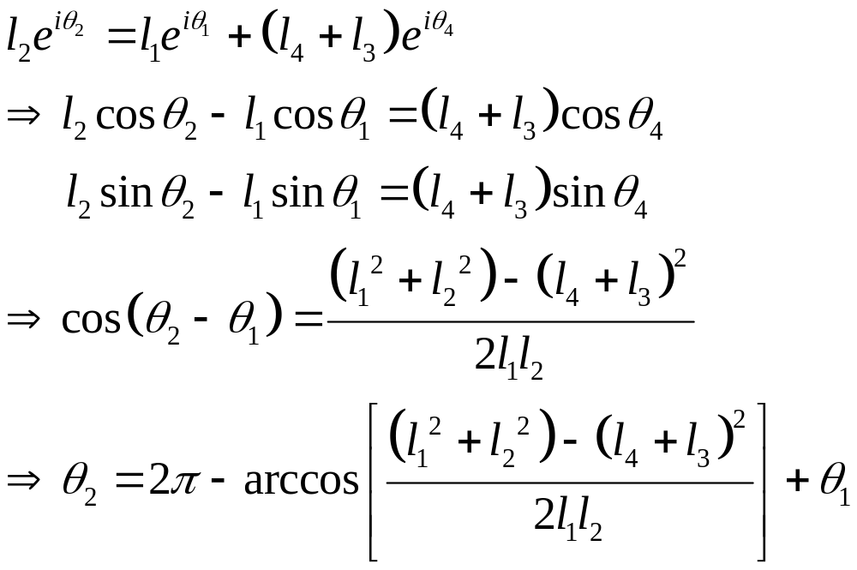
Limit Position Analysis of a Non Grashofian Double Rocker RRRR Linkages Using Complex Numbers
Im
Q
θ₄=θ₃
θ₂
l₁
θ₁
Re
O
l₄
θ₃
l₂
l₅
θ₅
l₃
Type I (L_{max}=L₁) : θ₂ - Another extreme position
P

Slide 4
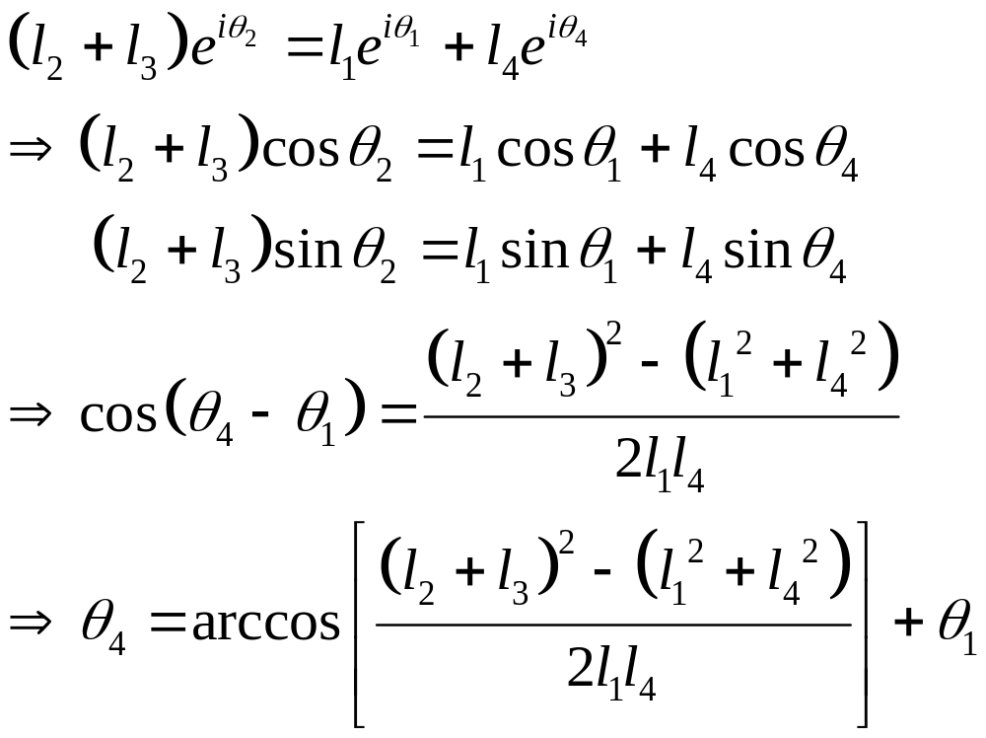
Limit Position Analysis of a Non Grashofian Double Rocker RRRR Linkages Using Complex Numbers
Type I (L_{max}=L₁) : θ₄ - one extreme position
Q
P
Im
θ₅
l₃
l₅
θ₃
l₄
l₂
θ₄
θ₂=θ₃
l₁
θ₁
Re
O

Slide 5
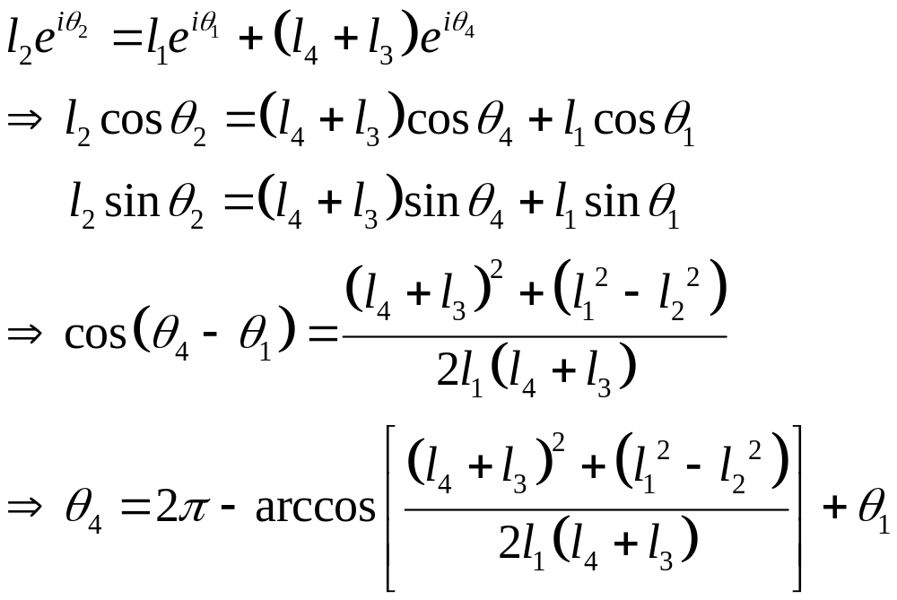
Limit Position Analysis of a Non Grashofian Double Rocker RRRR Linkages Using Complex Numbers
Im
Q
θ₄=θ₃
θ₂
l₁
θ₁
Re
O
l₄
θ₃
l₅
θ₅
l₃
Type I (L_{max}=L₁) : θ₄ - Another extreme position
l₂
P

Slide 6
Limit Position Analysis of a Non Grashofian Double Rocker RRRR Linkages Using Complex Numbers
Type II (L_{max}=L₂) : θ₂ - one extreme position
l₅
Q
θ₅
Im
l₃
θ₃
l₂
P
l₄
θ₄=θ₃
θ₂
θ₁
l₁
Re
O

Slide 7
Limit Position Analysis of a Non Grashofian Double Rocker RRRR Linkages Using Complex Numbers
Type II (L_{max}=L₂) : θ₂ - another extreme position
Im
l₁
θ₄=θ₃
θ₂
θ₁
Re
O
l₄
θ₃=θ₄
l₂
Q
P
θ₅
l₃
l₅

Slide 8
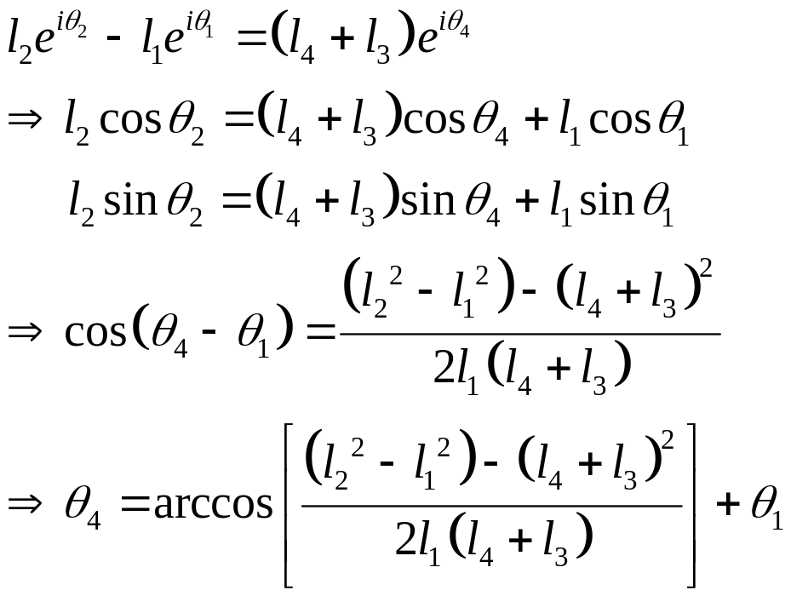
Limit Position Analysis of a Non Grashofian Double Rocker RRRR Linkages Using Complex Numbers
Type II (L_{max}=L₂) : θ₄ - one extreme position
l₅
Q
θ₅
Im
l₃
θ₃
l₂
P
l₄
θ₄=θ₃
θ₂
θ₁
l₁
Re
O

Slide 9
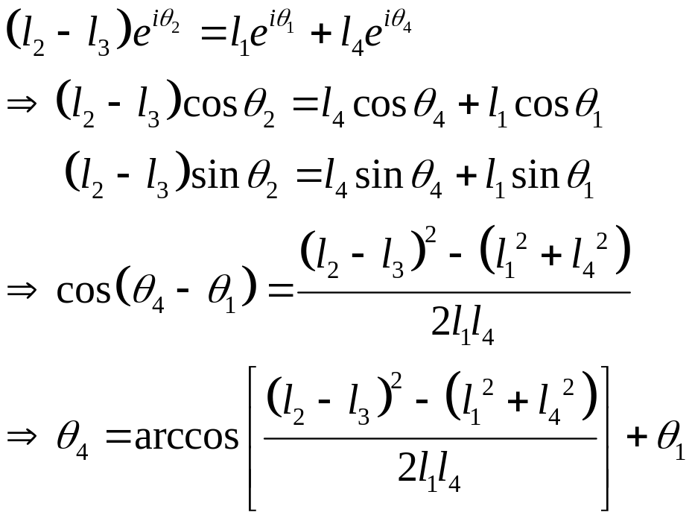
Limit Position Analysis of a Non Grashofian Double Rocker RRRR Linkages Using Complex Numbers
Type II (L_{max}=L₂) : θ₄ - another extreme position
Im
l₁
θ₄=θ₃
θ₂
θ₁
Re
O
l₄
l₂
l₃
θ₃=θ₄
θ₅
Q
l₅
P

Slide 10
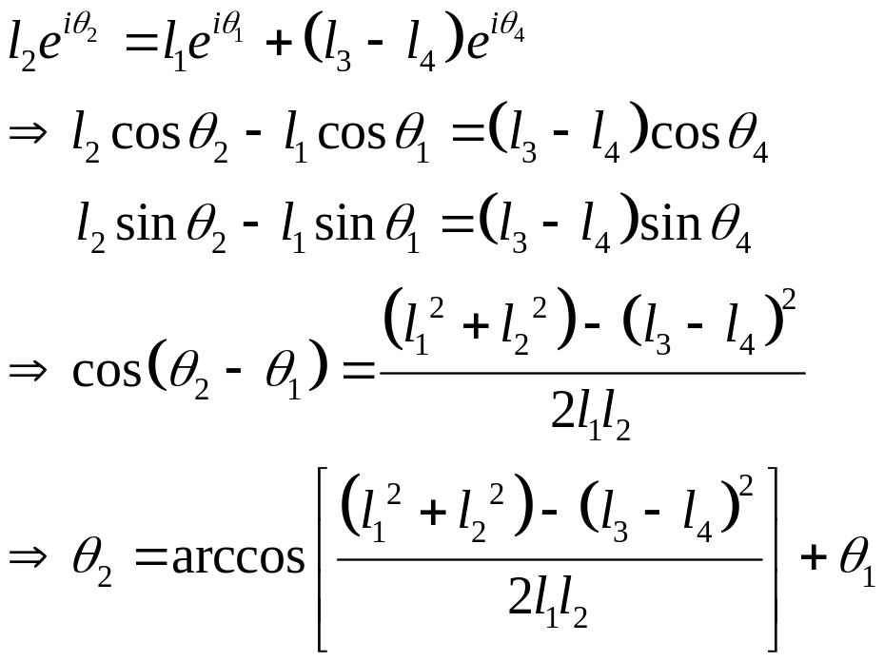
Limit Position Analysis of a Non Grashofian Double Rocker RRRR Linkages Using Complex Numbers
Type III (L_{max}=L₃) : θ₂ - one extreme position
Im
l₅
Q
θ₃
θ₅
l₂
θ₄=θ₃
l₃
θ₂
θ₁
l₁
Re
P
O
l₄

Slide 11
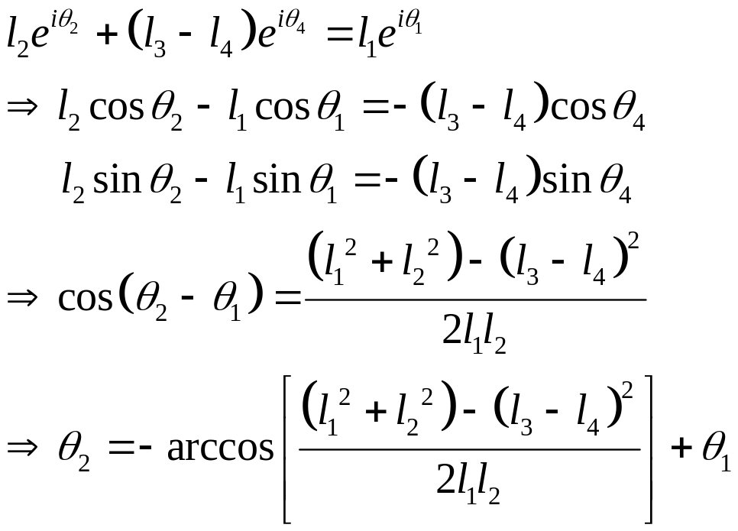
Limit Position Analysis of a Non Grashofian Double Rocker RRRR Linkages Using Complex Numbers
Type III (L_{max}=L₃) : θ₂ - another extreme position
Im
P
l₄
Q
l₅
θ₄=θ₃
θ₂
l₁
l₃
θ₁
θ₅
Re
O
l₂
θ₃

Slide 12
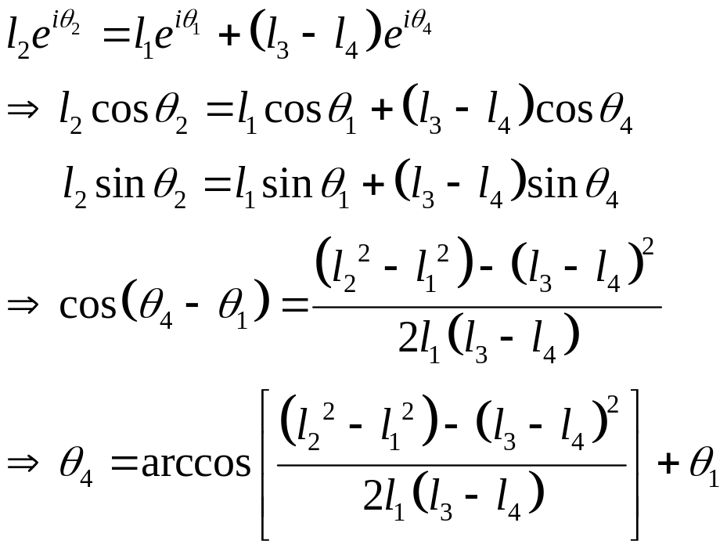
Limit Position Analysis of a Non Grashofian Double Rocker RRRR Linkages Using Complex Numbers
Type III (L_{max}=L₃) : θ₄ - one extreme position
Im
l₅
Q
θ₃
θ₅
l₂
θ₄=θ₃
l₃
θ₂
θ₁
l₁
Re
P
O
l₄

Slide 13

Limit Position Analysis of a Non Grashofian Double Rocker RRRR Linkages Using Complex Numbers
Type II (L_{max}=L₃) : θ₄ - one extreme position
Im
P
l₄
Q
l₃
θ₄
l₁
θ₂=θ₃+π
O
θ₁
Re
l₅
θ₅
l₂
θ₃

